Slide 1
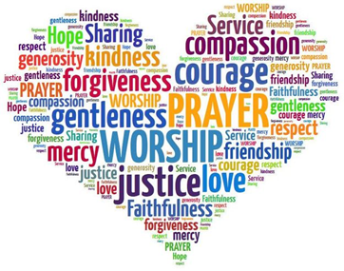
Collective Worship in School
A Guide to Greatness

Slide 2
Collective Worship in School
Church of England website states
Collective worship gives pupils and school staff the opportunity to:
Engage in an act of community.
Express praise and thanksgiving to God.
Be still and reflect.
Explore the big questions of life and respond to national events.
Foster respect and deepen spiritual awareness.
Reflect on the character of God and on the teachings of Christ.
Affirm Christian values and attitudes.
Share each other's joys and challenges.
Celebrate special times in the Christian calendar.

Slide 3
Collective Worship in School
Guide to Greatness
We need to call this time together Collective Worship not Assembly in Church Schools.

Slide 4
Collective Worship in School
Guide to Greatness
We are teaching the children a structure, which relates to Anglican acts of worship.
Focal point
Bible stories about God
Jesus’ teachings
Prayer
Choral worship (not singing)
Resemble a Church service

Slide 5
Collective Worship in School
Guide to Greatness
Structure – GERS approach
Gathering
Engaging
Response
Sending
Flippin’ Praise

Slide 6
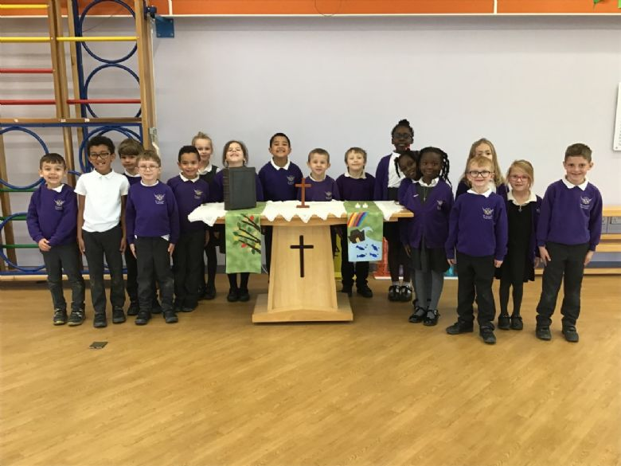
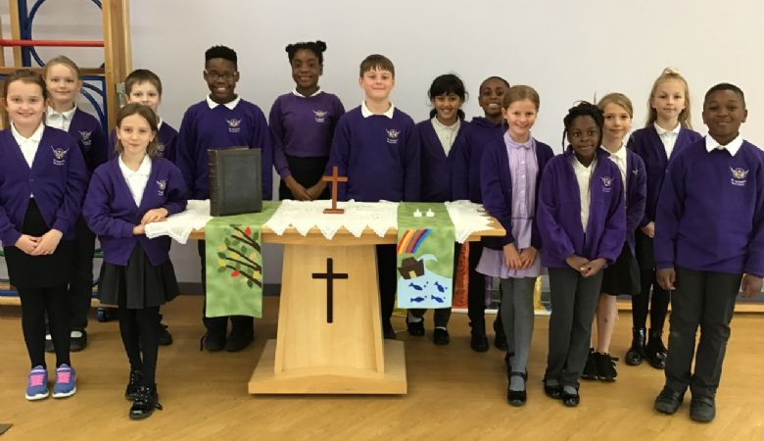
Collective Worship Leaders
Praise Partners
Have a group of children to help prepare, lead and support during CW.
Ask the children to apply in writing to tell you why they will be able to succeed in the role and support the younger in school.

Slide 7
Collective Worship Leaders
Praise Partners
Prepare the physical worship space
Welcome/Goodbye at the door
Lead a wave to welcome all
Say the lead and response
Demonstrate song signing
Support with acting/role play
Dress the altar - Trinity
Lead and write prayers

Slide 8
Gathering - Greeting
Music
Use some inspirational music or focus songs for your children’s entrance.
This happens in church – it creates a calm and focussed environment. Children will join in with singing rather than creating those little whispers.
Hillsong Matt Redman
Rend Collective Kids CAIN
Cornerstone Pentatonix
CJ & Friends Bethel Music

Slide 9
Gathering - Greeting
Welcome Wave
This helps us to feel united as a Church school family.
This is similar to the acts of peace in Church.
l

Slide 10
Greet and Respond
Gathering - Greeting
In Church, there are moments of lead and response. This can happen in CW time too to unite the gathering.
Lift up your hearts, | We lift them up to the Lord
This is the day the Lord has made, | Let us rejoice and be glad in it
Whatever you do work at it with all your heart | As if working for the Lord
Peace be with you | And also with you
I will give thanks to you Lord | I will tell of your marvellous works
Come on in everyone | Shout to the Lord with joyful praise
Jesus, light of the world, is here | Lord Jesus, shine upon us
God is good! God is great! | Praise him!
The Lord is here | And his spirit is with us

Slide 11
The Altar
Gathering and Responding
The Trinitarian nature of God can be represented through symbols on the altar.
Teaching children that God - is the Father, the Son and the Holy Spirit - 3 in 1.
Bible for God the Father
Cross for God the Son
Candle for God the Holy Spirit
EYFS/KS1 take one symbol each
KS2 one person for all 3 symbols

Slide 12
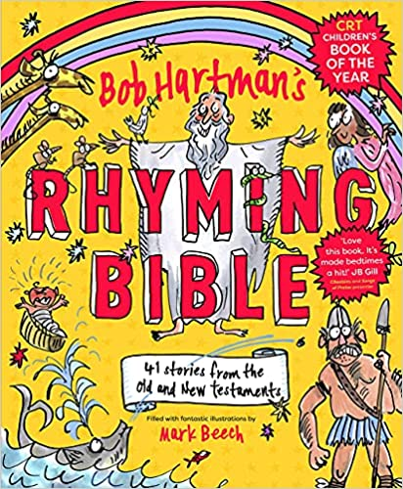
Gathering and Responding
As a Church school, you should encourage and support but do not force children to engage with the Bible, Christian teachings or with God.
Some great examples of modern and internet Bibles.

Slide 13
Gathering and Responding
As a Church school, you should encourage and support but do not force children to engage with the Bible, Christian teachings or with God.
Saddleback Kids
Rod The Ney

Slide 14
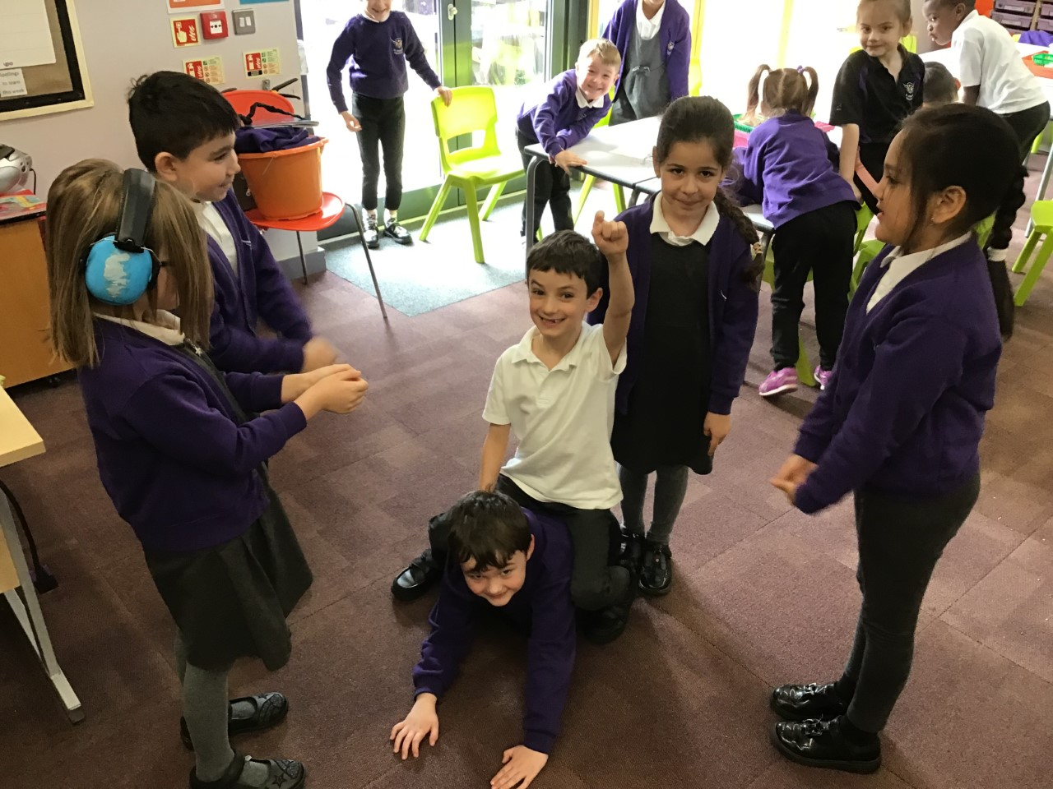
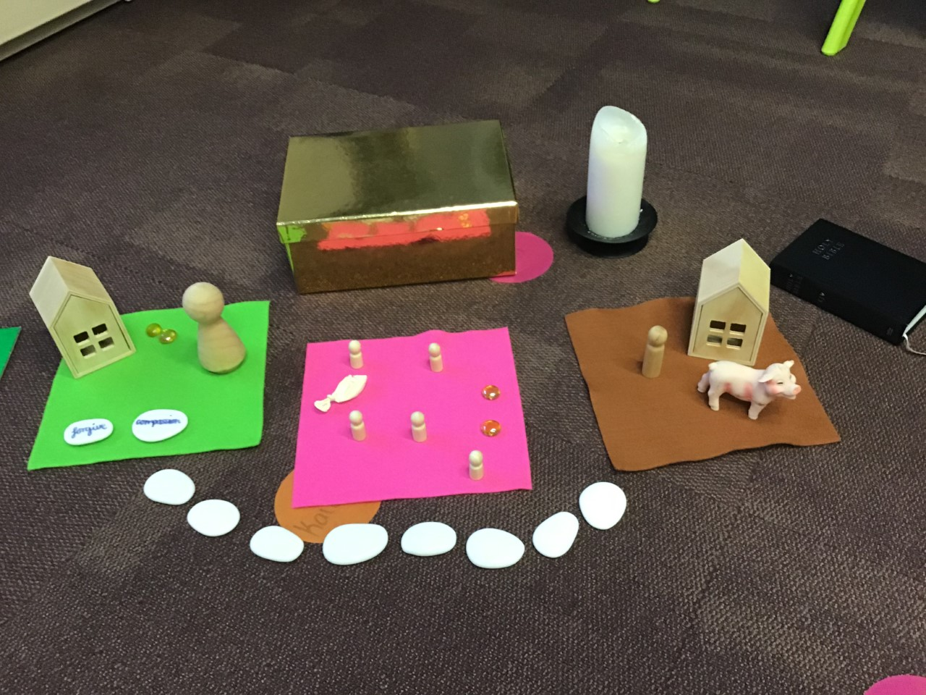
Gathering and Responding
As a Church school, you should encourage and support but do not force children to engage with the Bible, Christian teachings or with God.
Role play
Drama
Freeze frame
Spirited Play
Dressing up
Games

Slide 15
Gathering and Responding
Good CW makes the links to
RE learning in the classroom
School values and vision
Teachings of Jesus

Slide 16
Gathering and Responding
Allow time for reflection and thinking.
Ask the children prompting questions without necessarily expecting an answer.

Slide 17
Responding
Choral Worship NOT singing
Aim to praise the Lord with your voices.
Stand to show respect and raise voices.
Move to worship.
Add Makaton/BSL signs and actions.
Singing – Endorphins.
All join in!

Slide 18
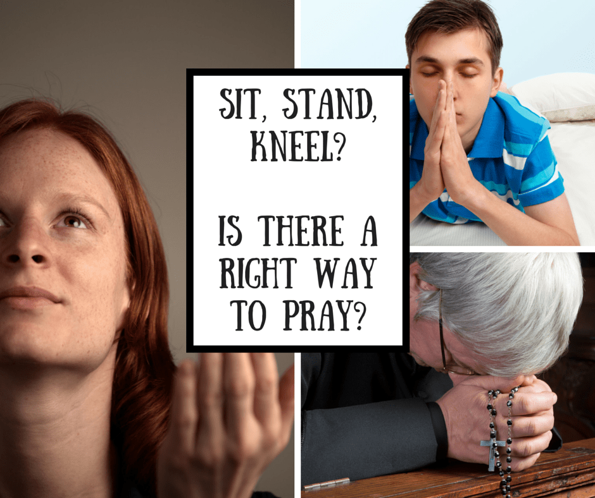
Responding
Prayer
Only invite children to join in praying.
Offer different positions – think about how different people and faiths pray.

Slide 19
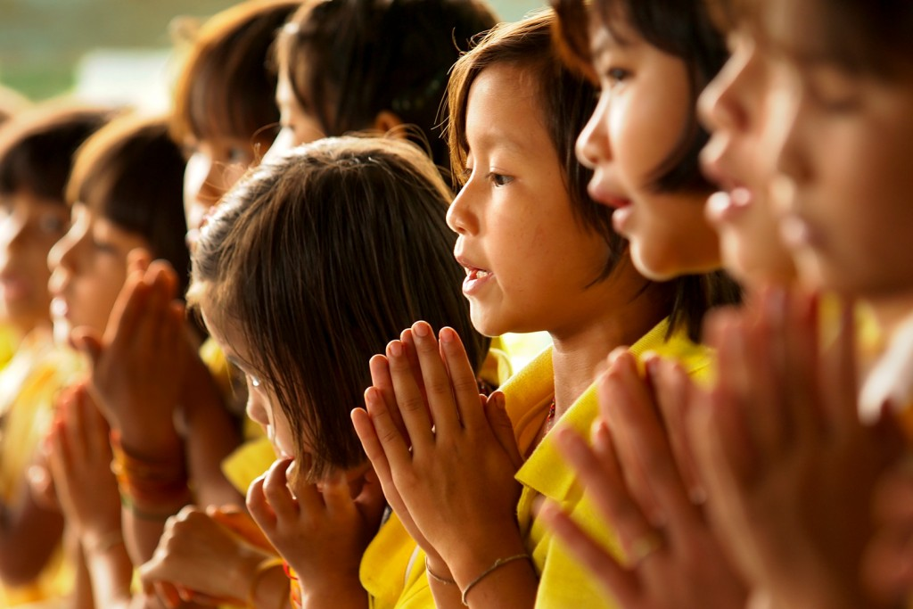
Responding
Prayer
Consider writing a whole school script, it allows for consistency and transparency:
“I invite you to please find that quiet place inside of you, find that still place and if you would like to join in and make it your prayer then join in. If you choose to reflect, sit quietly and think about…’
Offer an idea for the children to reflect or think about, relate to your CW focus or something happening in the world.

Slide 20
Responding
Prayer
You do not always need to use the same one. Consider:
Children’s Own Prayers
Your School Prayer
The Lord’s Prayer
Grace Prayer
Lunchtime Prayer
Home-time Prayer
Themed Prayer
Intercession Prayers

Slide 21
Sending
The end of C/W should be purposeful and encourage reverence.
Close the Bible, lay the cross and extinguish the candle.
Ask children to join in with the Grace.
Play reflective music or a song that embraces the focus of the CW.
Leave a reflection point or thinking time question.

Slide 22
My details again…
Jemma Coulson
jemma.coulson@elydiocese.org
education@elydiocese.org
07538 099 177

